Slide 1
Chapter 4: Greedy Algorithms (II)
Fall 2013
Prof. Peng-Jun Wan

Slide 2
4.5 Minimum Spanning Tree

Slide 3
Minimum Spanning Tree
Minimum spanning tree. Given a connected graph G = (V, E) with real-valued edge weights c_{e}, an MST is a subset of the edges T ⊆ E such that T is a spanning tree whose sum of edge weights is minimized.
Cayley's Theorem. There are n^{n-2} spanning trees of K_{n}.
4
24
4
6
23
9
9
18
6
5
11
5
11
16
8
8
14
7
7
10
21
G = (V, E)
T, Σ_{e∈T} c_{e} = 50
can't solve by brute force
Notes:
Cayley (1821-1895) was one of great mathematicians of 19th century, but his 1889 paper did not contain a rigorous proof of Cayley's Theorem.

Slide 4
Applications
MST is fundamental problem with diverse applications.
  Network design.
    telephone, electrical, hydraulic, TV cable, computer, road
  Approximation algorithms for NP-hard problems.
    traveling salesperson problem, Steiner tree
  Indirect applications.
    max bottleneck paths
    LDPC codes for error correction
    image registration with Renyi entropy
    learning salient features for real-time face verification
    reducing data storage in sequencing amino acids in a protein
    model locality of particle interactions in turbulent fluid flows
    autoconfig protocol for Ethernet bridging to avoid cycles in a network
  Cluster analysis.
Notes:
Applications: http://www1.ics.uci.edu/~eppstein/gina/mst.html, Ahuja, Magnanti, Orlin Section 13.2

Slide 5
Greedy Algorithms
Kruskal's algorithm. Start with T = φ. Consider edges in ascending order of cost. Insert edge e in T unless doing so would create a cycle.
Reverse-Delete algorithm. Start with T = E. Consider edges in descending order of cost. Delete edge e from T unless doing so would disconnect T.
Prim's algorithm. Start with some root node s and greedily grow a tree T from s outward. At each step, add the cheapest edge e to T that has exactly one endpoint in T.
Remark. All three algorithms produce an MST.

Slide 6
Greedy Algorithms
Simplifying assumption. All edge costs c_{e} are distinct.
Cut property. Let S be any subset of nodes, and let e be the min cost edge with exactly one endpoint in S. Then the MST contains e.
Cycle property. Let C be any cycle, and let f be the max cost edge belonging to C. Then the MST does not contain f.
C
f
S
e
e is in the MST
f is not in the MST
Notes:
Note: simplifying assumption guarantees that MST in unique so it make sense to refer to "the MST"

Slide 7
Cycles and Cuts
Cycle. Set of edges the form a-b, b-c, c-d, …, y-z, z-a.
Cutset. A cut is a subset of nodes S. The corresponding cutset D is the subset of edges with exactly one endpoint in S.
2
3
1
6
4
Cycle C = 1-2, 2-3, 3-4, 4-5, 5-6, 6-1
5
7
8
2
3
1
Cut S = { 4, 5, 8 }
Cutset D = 5-6, 5-7, 3-4, 3-5, 7-8
6
4
5
7
8

Slide 8
Cycle-Cut Intersection
Claim. A cycle and a cutset intersect in an even number of edges.
Pf. (by picture)
2
3
1
Cycle C = 1-2, 2-3, 3-4, 4-5, 5-6, 6-1
Cutset D = 3-4, 3-5, 5-6, 5-7, 7-8
Intersection = 3-4, 5-6
6
4
5
7
8
C
S
V - S

Slide 9
Greedy Algorithms
Simplifying assumption. All edge costs c_{e} are distinct.
Cut property. Let S be any subset of nodes, and let e be the min cost edge with exactly one endpoint in S. Then the MST T* contains e.
Pf. (exchange argument)
  Suppose e does not belong to T*, and let's see what happens.
  Adding e to T* creates a cycle C in T*.
  Edge e is both in the cycle C and in the cutset D corresponding to S ⇒ there exists another edge, say f, that is in both C and D.
  T' = T* ∪ { e } - { f } is also a spanning tree.
  Since c_{e} < c_{f}, cost(T') < cost(T*).
  This is a contradiction. ▪
f
S
e
T*

Slide 10
Greedy Algorithms
Simplifying assumption. All edge costs c_{e} are distinct.
Cycle property. Let C be any cycle in G, and let f be the max cost edge belonging to C. Then the MST T* does not contain f.
Pf. (exchange argument)
  Suppose f belongs to T*, and let's see what happens.
  Deleting f from T* creates a cut S in T*.
  Edge f is both in the cycle C and in the cutset D corresponding to S ⇒ there exists another edge, say e, that is in both C and D.
  T' = T* ∪ { e } - { f } is also a spanning tree.
  Since c_{e} < c_{f}, cost(T') < cost(T*).
  This is a contradiction. ▪
f
S
e
T*

Slide 11
Prim's Algorithm: Proof of Correctness
Prim's algorithm. [Jarník 1930, Dijkstra 1957, Prim 1959]
  Initialize S = any node.
  Apply cut property to S.
  Add min cost edge in cutset corresponding to S to T, and add one new explored node u to S.
S

Slide 12
Implementation: Prim's Algorithm
Implementation. Use a priority queue ala Dijkstra.
  Maintain set of explored nodes S.
  For each unexplored node v, maintain attachment cost a[v] = cost of cheapest edge v to a node in S.
  O(n²) with an array; O(m log n) with a binary heap.
Prim(G, c) {
foreach (v ∈ V) a[v] ← ∞
Initialize an empty priority queue Q
foreach (v ∈ V) insert v onto Q
Initialize set of explored nodes S ← φ
while (Q is not empty) {
u ← delete min element from Q
S ← S ∪ { u }
foreach (edge e = (u, v) incident to u)
if ((v ∉ S) and (c_{e} < a[v]))
decrease priority a[v] to c_{e}
}

Slide 13
Kruskal's Algorithm: Proof of Correctness
Kruskal's algorithm. [Kruskal, 1956]
  Consider edges in ascending order of weight.
  Case 1: If adding e to T creates a cycle, discard e according to cycle property.
  Case 2: Otherwise, insert e = (u, v) into T according to cut property where S = set of nodes in u's connected component.
v
e
S
e
u
Case 1
Case 2

Slide 14
Implementation: Kruskal's Algorithm
Implementation. Use the union-find data structure.
  Build set T of edges in the MST.
  Maintain set for each connected component.
  O(m log n) for sorting and O(m α (m, n)) for union-find.
m ≤ n² ⇒ log m is O(log n)
essentially a constant
Kruskal(G, c) {
Sort edges weights so that c₁ ≤ c₂ ≤ ... ≤ c_{m}.
T ← φ
foreach (u ∈ V) make a set containing singleton u
for i = 1 to m
(u,v) = e_{i}
if (u and v are in different sets) {
T ← T ∪ {e_{i}}
merge the sets containing u and v
}
return T
}
are u and v in different connected components?
merge two components

Slide 15
Lexicographic Tiebreaking
To remove the assumption that all edge costs are distinct: perturb all edge costs by tiny amounts to break any ties.
Impact. Kruskal and Prim only interact with costs via pairwise comparisons. If perturbations are sufficiently small, MST with perturbed costs is MST with original costs.
Implementation. Can handle arbitrarily small perturbations implicitly by breaking ties lexicographically, according to index.
e.g., if all edge costs are integers,
perturbing cost of edge e_{i} by i / n²
boolean less(i, j) {
if (cost(e_{i}) < cost(e_{j})) return true
else if (cost(e_{i}) > cost(e_{j})) return false
else if (i < j) return true
else return false
}

Slide 16
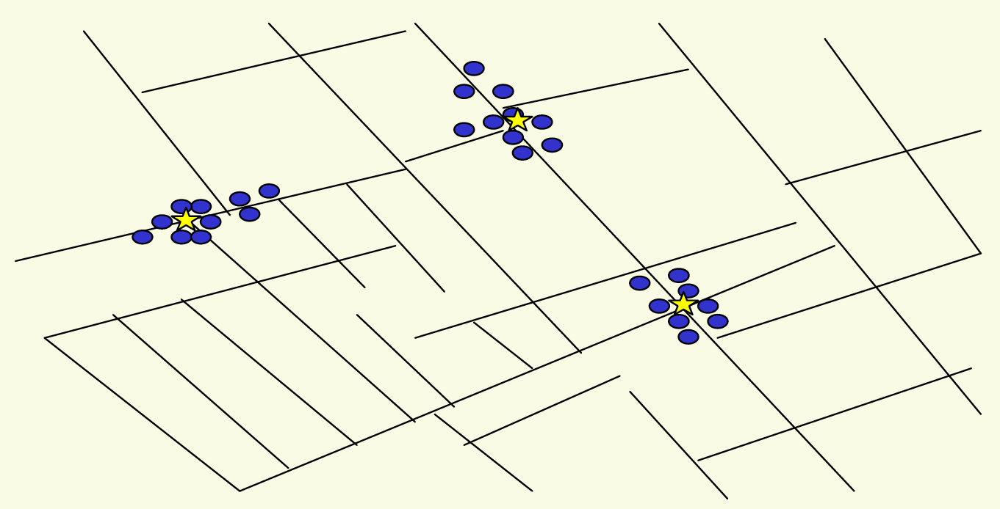
4.7 Clustering
Outbreak of cholera deaths in London in 1850s.
Reference: Nina Mishra, HP Labs
Notes:
History: London physicist John Snow plotted outbreak of cholera deaths on map in 1850s
location indicated that clusters were around certain intersections with polluted wells; this exposed the problem and solution!

Slide 17
Clustering
Clustering. Given a set U of n objects labeled p₁, …, p_{n}, classify into coherent groups.
Distance function. Numeric value specifying "closeness" of two objects.
Fundamental problem. Divide into clusters so that points in different clusters are far apart.
  Routing in mobile ad hoc networks.
  Identify patterns in gene expression.
  Document categorization for web search.
  Similarity searching in medical image databases
  Skycat: cluster 10⁹ sky objects into stars, quasars, galaxies.
photos, documents. micro-organisms
number of corresponding pixels whose
intensities differ by some threshold
Notes:
skycat: 7 dimensional vectors, each coordinate represents radiation in some band of the spectrum
Sloan Sky Survey: cluster entire visible universe

Slide 18
Clustering of Maximum Spacing
k-clustering. Divide objects into k non-empty groups.
Distance function. Assume it satisfies several natural properties.
  d(p_{i}, p_{j}) = 0 iff p_{i} = p_{j} (identity of indiscernibles)
  d(p_{i}, p_{j}) ≥ 0 (nonnegativity)
  d(p_{i}, p_{j}) = d(p_{j}, p_{i}) (symmetry)
Spacing. Min distance between any pair of points in different clusters.
Clustering of maximum spacing. Given an integer k, find a k-clustering of maximum spacing.
spacing
k = 4
Notes:
semimetric: not necessarily a metric space (no triangle inequality)
Ex: assumes Euclidean distance function

Slide 19
Greedy Clustering Algorithm
Single-link k-clustering algorithm.
  Form a graph on the vertex set U, corresponding to n clusters.
  Find the closest pair of objects such that each object is in a different cluster, and add an edge between them.
  Repeat n-k times until there are exactly k clusters.
Key observation. This procedure is precisely Kruskal's algorithm
(except we stop when there are k connected components).
Remark. Equivalent to finding an MST and deleting the k-1 most expensive edges.
Notes:
Agglomerative clustering. Build tree bottom up.
Divisive clustering. Build tree top down.

Slide 20
Greedy Clustering Algorithm: Analysis
Theorem. Let C* denote the clustering C*₁, …, C*_{k} formed by deleting the
k-1 most expensive edges of a MST. C* is a k-clustering of max spacing.
Pf. Let C denote some other clustering C₁, …, C_{k}.
  The spacing of C* is the length d* of the (k-1)^{st} most expensive edge.
  Let p_{i}, p_{j} be in the same cluster in C*, say C*_{r}, but different clusters in C, say C_{s} and C_{t}.
  Some edge (p, q) on p_{i}-p_{j} path in C*_{r} spans two different clusters in C.
  All edges on p_{i}-p_{j} path have length ≤ d*
  since Kruskal chose them.
  Spacing of C is ≤ d* since p and q
  are in different clusters. ▪
C_{s}
C_{t}
C*_{r}
p_{i}
p
q
p_{j}

Slide 21
Extra Slides

Slide 22
MST Algorithms: Theory
Deterministic comparison based algorithms.
  O(m log n) [Jarník, Prim, Dijkstra, Kruskal, Boruvka]
  O(m log log n). [Cheriton-Tarjan 1976, Yao 1975]
  O(m β(m, n)). [Fredman-Tarjan 1987]
  O(m log β(m, n)). [Gabow-Galil-Spencer-Tarjan 1986]
  O(m α (m, n)). [Chazelle 2000]
Holy grail. O(m).
Notable.
  O(m) randomized. [Karger-Klein-Tarjan 1995]
  O(m) verification. [Dixon-Rauch-Tarjan 1992]
Euclidean.
  2-d: O(n log n). compute MST of edges in Delaunay
  k-d: O(k n²). dense Prim
Notes:
Idea for O(m log log n): combine Boruvka + Prim. (see CLR 24-2)
Chazelle: soft heaps, lower bound tight over arbitrary semi-group

Slide 23
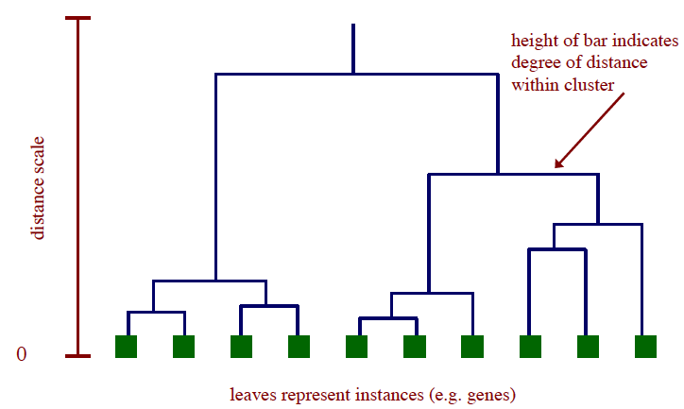
Dendrogram
Dendrogram. Scientific visualization of hypothetical sequence of evolutionary events.
  Leaves = genes.
  Internal nodes = hypothetical ancestors.
Reference: http://www.biostat.wisc.edu/bmi576/fall-2003/lecture13.pdf
Notes:
also need an algorithm to order leaves optimally

Slide 24
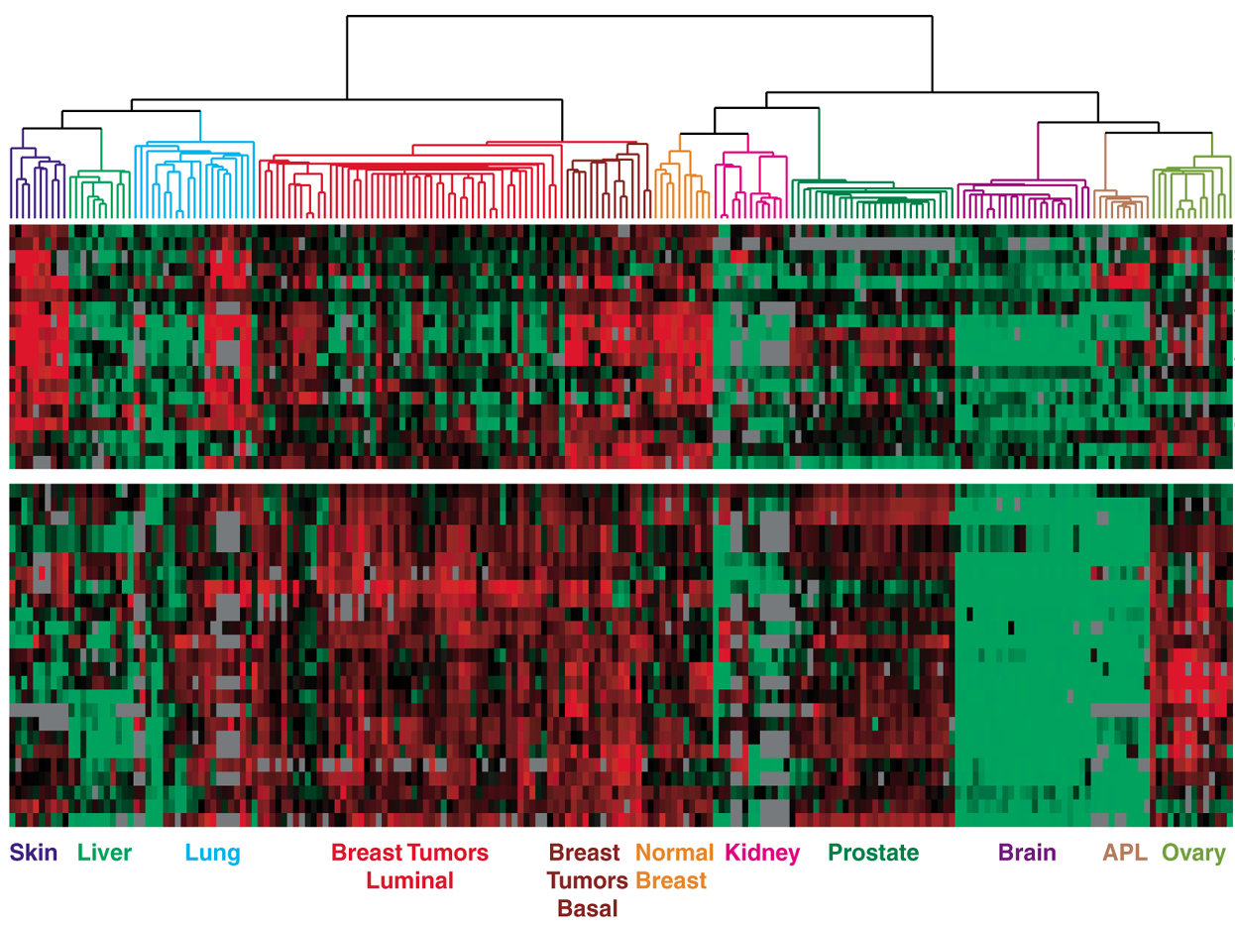
Dendrogram of Cancers in Human
Tumors in similar tissues cluster together.
Gene 1
Gene n
Reference: Botstein & Brown group
gene expressed
gene not expressed
Notes:
slide borrowed with permission from Olga Troyanskaya
"Microarrays allow us to see if a particular gene is on or off in a particular tissue. The colors on this picture correspond to whether or not the gene is expressed. So each row is a gene, and each column is a particular experiment, for example a particular type of tissue. If you see a red spot for some gene <show gene> for breast tumors, that means this gene is expressed in breast cancer. But that same gene is not expressed in the brain, for example."
arranging the experiments (columns) for optimal presentation is also an interesting problem

